Slide 1

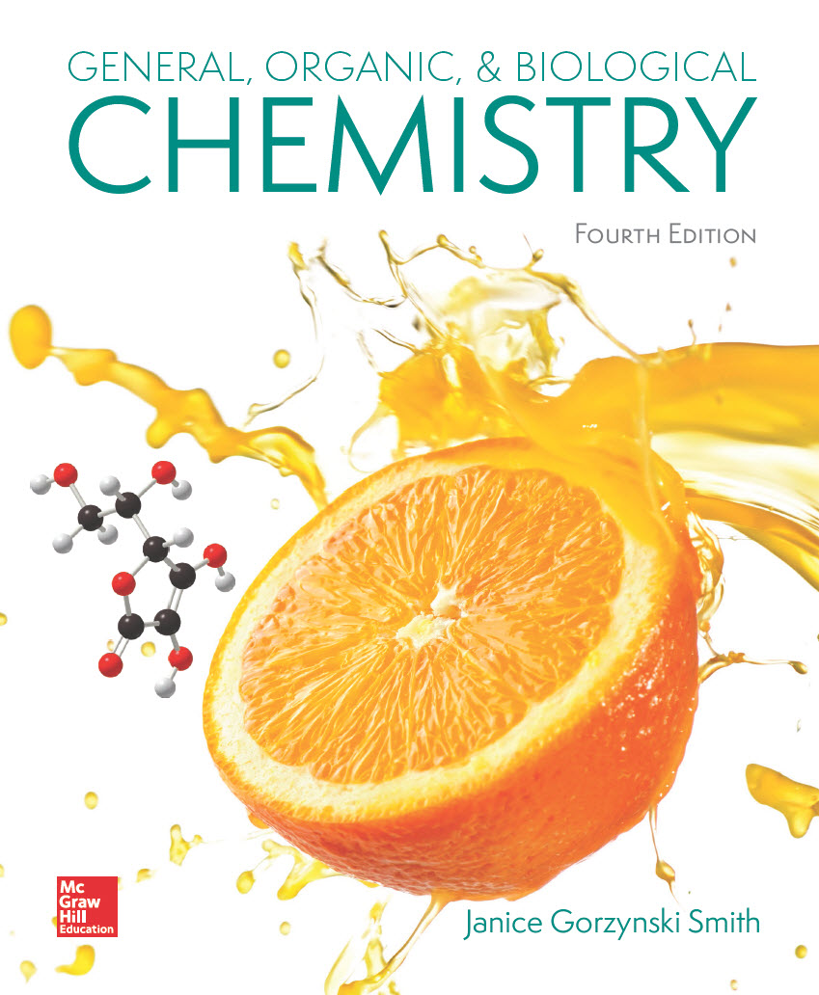
Chapter 6
Lecture Outline
Prepared by
Harpreet Malhotra
Florida State College at Jacksonville

Slide 2
6.1 Energy (1)
Energy is the capacity to do work.
Potential energy is stored energy.
Kinetic energy is the energy of motion.
The law of conservation of energy states that the total energy in a system does not change. Energy cannot be created or destroyed.

Slide 3
6.1 Energy (2)
Chemical bonds store potential energy.
A compound with lower potential energy is more stable than a compound with higher potential energy.
Reactions that form products having lower potential energy than the reactants are favored.

Slide 4
6.1 Energy (3)
The Units of Energy
A calorie (cal) is the amount of energy needed to raise the temperature of 1 g of water by
A joule (J) is another unit of energy.
1 cal = 4.184 J
Both joules and calories can be reported in the larger units kilojoules (kJ) and kilocalories (kcal).
1,000 J = 1 kJ
1,000 cal = 1 kcal
1 kcal = 4.184 kJ

Slide 5
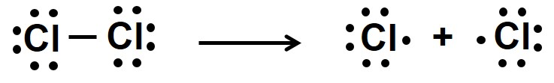
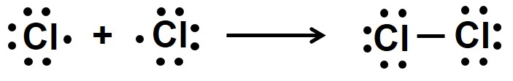
6.2 Energy Changes in Reactions (1)
When molecules come together and react, bonds are broken in the reactants and new bonds are formed in the products.
Bond breaking always requires an input of energy.
To cleave this bond, 58 kcal/mol must be added.
Bond formation always releases energy.
To form this bond, 58 kcal/mol is released.

Slide 6
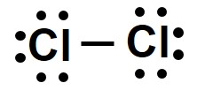
6.2 Energy Changes in Reactions (2)
Bond Dissociation Energy
ΔH is the energy absorbed or released in a reaction; it is called the heat of reaction or the enthalpy change.
When energy is absorbed, the reaction is said to be endothermic and ΔH is positive (+).
When energy is released, the reaction is said to be exothermic and ΔH is negative (−).
To cleave this bond, ΔH = +58 kcal/mol (Endothermic)
To form this bond, ΔH = −58 kcal/mol (Exothermic)

Slide 7
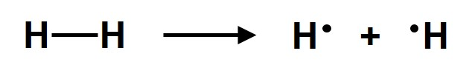
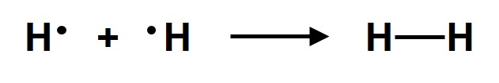
6.2 Energy Changes in Reactions (3)
Bond Dissociation Energy
The bond dissociation energy is the ΔH for breaking a covalent bond by equally dividing the e⁻ between the two atoms.
Bond dissociation energies are positive values, because bond breaking is endothermic (ΔH > 0).
ΔH = +104 kcal/mol
Bond formation always has negative values, because. bond formation is exothermic (ΔH < 0).
ΔH = −104 kcal/mol

Slide 8
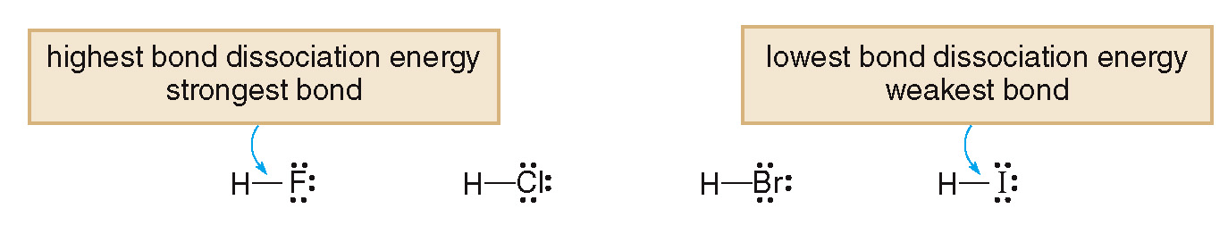
6.2 Energy Changes in Reactions (4)
Bond Dissociation Energy
The stronger the bond, the higher its bond dissociation energy.
In comparing bonds formed from elements in the same group, bond dissociation energies generally decrease going down the column.
ΔH =
+ 136 kcal/mol
+ 103 kcal/mol
+ 88 kcal/mol
+ 71 kcal/mol

Slide 9
6.2 Energy Changes in Reactions (5)
Calculations Involving ΔH Values
ΔH indicates the relative strength of the bonds
broken and formed in a reaction.
When ΔH is negative:
More energy is released in forming bonds than is needed to break the bonds.
The bonds formed in the products are stronger than the bonds broken in the reactants.
ΔH = −213 kcal/mol Heat is released

Slide 10
6.2 Energy Changes in Reactions (6)
Calculations Involving ΔH Values
When ΔH is positive:
More energy is needed to break bonds than is released in the formation of new bonds.
The bonds broken in the reactants are stronger than the bonds formed in the products.
ΔH = +678 kcal/mol Heat is absorbed

Slide 11
6.2 Energy Changes in Reactions (7)
Calculations Involving ΔH Values
Table 6.3 Endothermic and Exothermic Reactions
Endothermic Reaction | Exothermic Reaction
Heat is absorbed. | Heat is released.
ΔH is positive. | ΔH is negative.
The bonds broken in the reactants are stronger than the bonds formed in the products. | The bonds formed in the product are stronger than the bonds broken in the reactants.
The products are higher in energy than the reactants. | The products are lower in energy than the reactants.

Slide 12
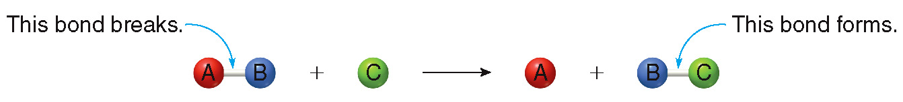
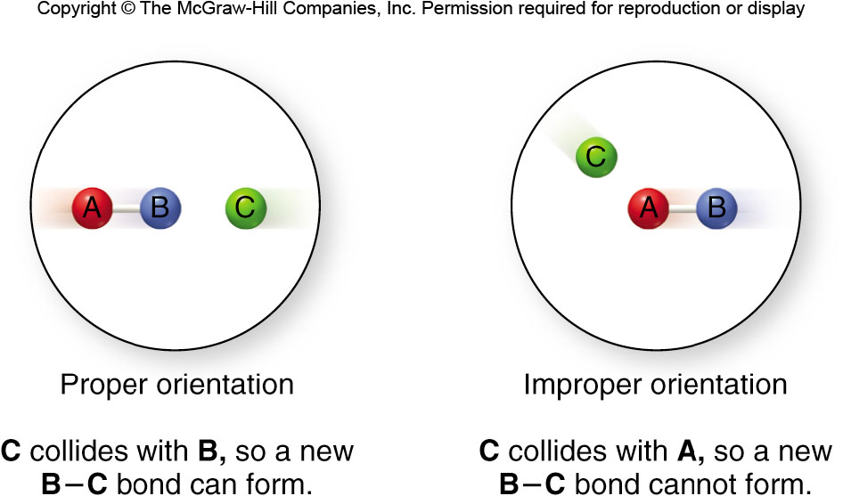
6.3 Energy Diagrams (1)
For a reaction to occur, two molecules must collide
with enough kinetic energy to break bonds.
The orientation of the two molecules must be correct as well.

Slide 13
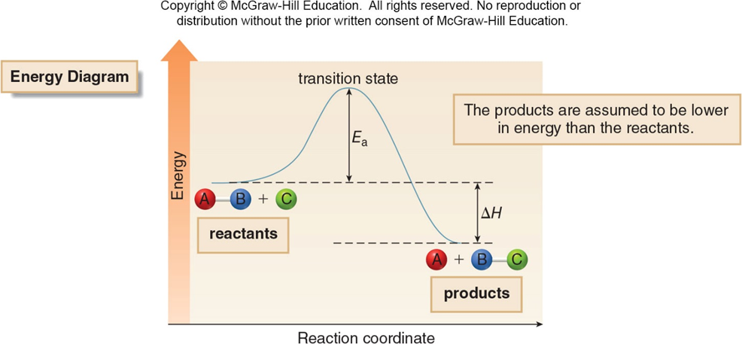
6.3 Energy Diagrams (2)
, the energy of activation, is the difference in
energy between the reactants and the transition state.

Slide 14
6.3 Energy Diagrams (3)
The
is the minimum amount of energy that the
reactants must possess for a reaction to occur.
is called the energy barrier and the height of the
barrier determines the reaction rate.
When the
is high, few molecules have enough
energy to cross the energy barrier, and the reaction is slow.
When the
is low, many molecules have enough
energy to cross the energy barrier, and the reaction is fast.

Slide 15
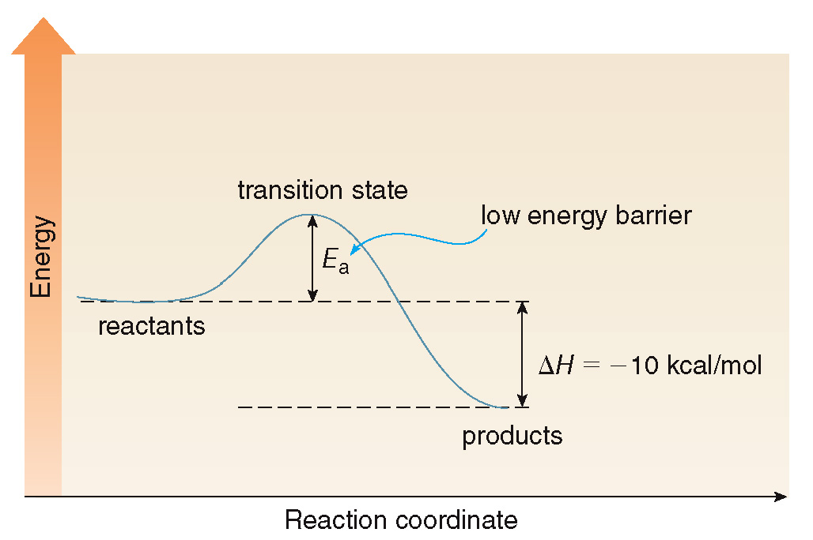
6.3 Energy Diagrams (4)
The difference in energy between the reactants and the products is the ΔH.
If ΔH is negative, the reaction is exothermic:

Slide 16
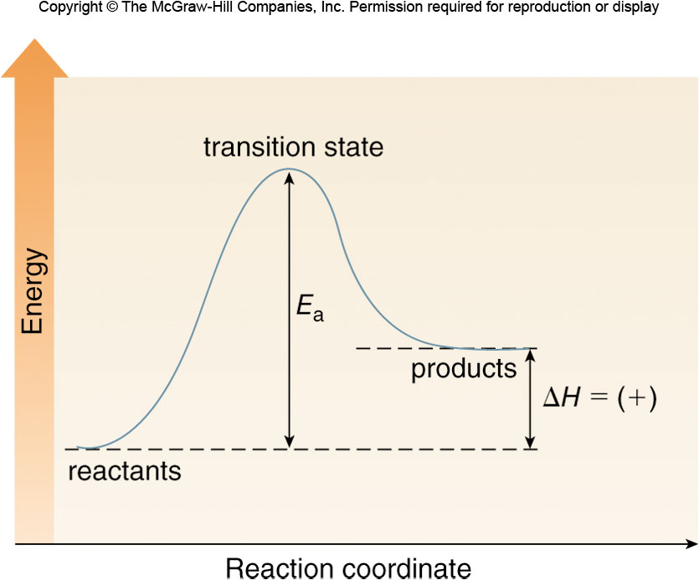
6.3 Energy Diagrams (5)
If ΔH is positive, the reaction is endothermic:

Slide 17
6.4 Reaction Rates (6)
How Concentration and Temperature
Affect Reaction Rate
Increasing the concentration of the reactants:
Increases the number of collisions
Increases the reaction rate
Increasing the temperature of the reaction:
Increases the average kinetic energy of the molecules
Increases the reaction rate

Slide 18
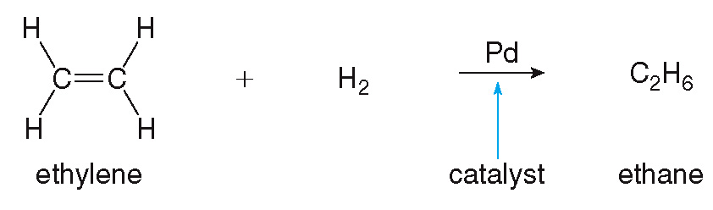
6.4 Reaction Rates (7)
Catalysts
A catalyst is a substance that speeds up the rate of a reaction.
A catalyst is recovered unchanged in a reaction, and does not appear in the product.
Catalysts accelerate a reaction by lowering
without affecting ΔH.

Slide 19
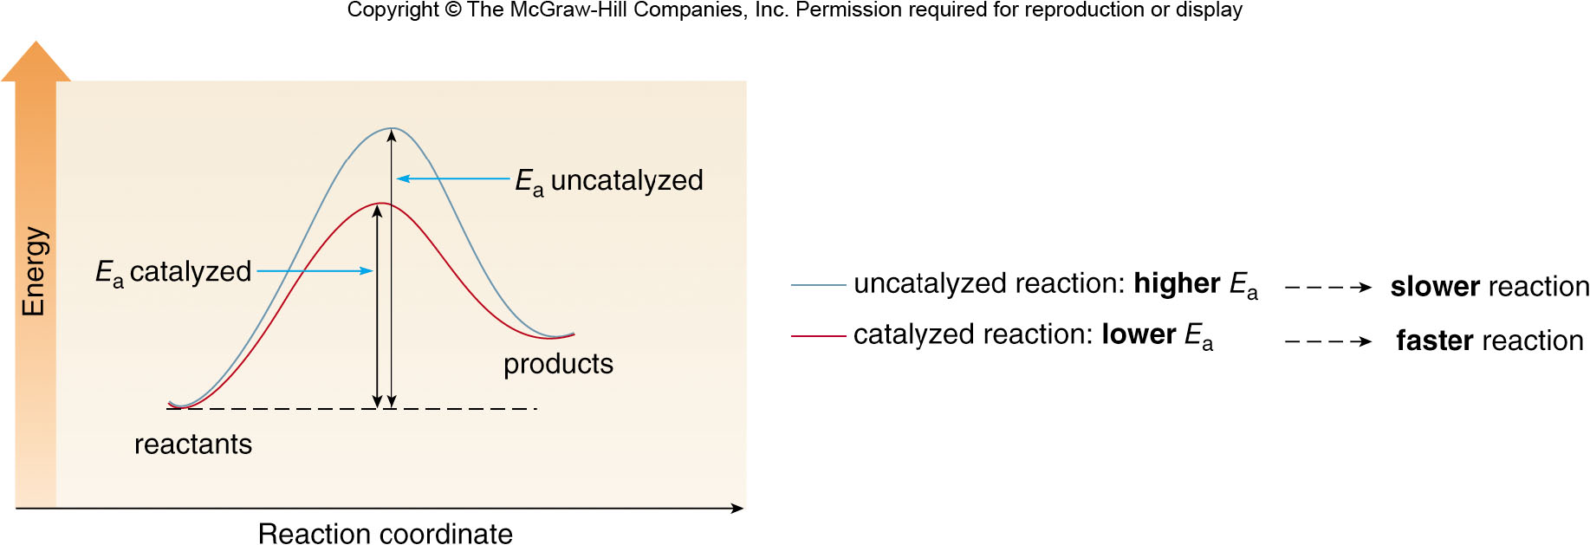
6.4 Reaction Rates (8)
Catalysts
The uncatalyzed reaction (higher
) is slower.
The catalyzed reaction (lower
) is faster.
ΔH is the same for both reactions.

Slide 20
6.4 Reaction Rates (9)
Focus on the Human Body: Biological Catalysts
Enzymes (usually protein molecules) are biological catalysts held together in a very specific three-dimensional shape.
The active site binds a reactant, which then undergoes a very specific reaction with an enhanced rate.
The enzyme lactase converts the carbohydrate lactose into the two sugars glucose and galactose.
People who lack adequate amounts of lactase suffer from intestinal issues; they cannot digest lactose when it is ingested.

Slide 21
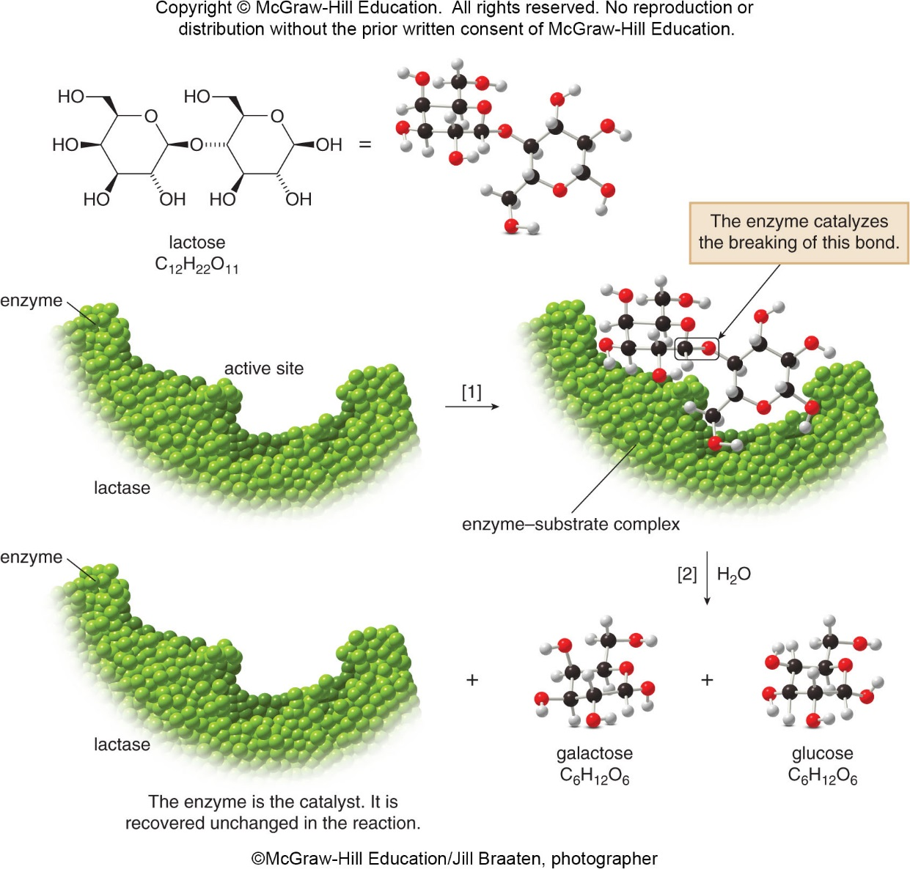
6.4 Reaction Rates (10)
Focus on the Human Body: Biological Catalysts
©McGraw-Hill Education/Jill Braaten, photographer

Slide 22
6.5 Equilibrium (1)
A reversible reaction can occur in either direction.
The forward reaction proceeds to the right.
The reverse reaction proceeds to the left.
The system is at equilibrium when the rate of the forward reaction equals the rate of the reverse reaction.
The net concentrations of reactants and products do not change at equilibrium.

Slide 23
6.5 Equilibrium (2)
The Equilibrium Constant
The relationship between the concentration of the products and the concentration of the reactants is the equilibrium constant, K.
Brackets, [ ], are used to symbolize concentration in moles per liter (mol/L).
For the reaction:

Slide 24
6.5 Equilibrium (3)
The Equilibrium Constant
For the following balanced chemical equation:
The coefficient becomes the exponent.

Slide 25
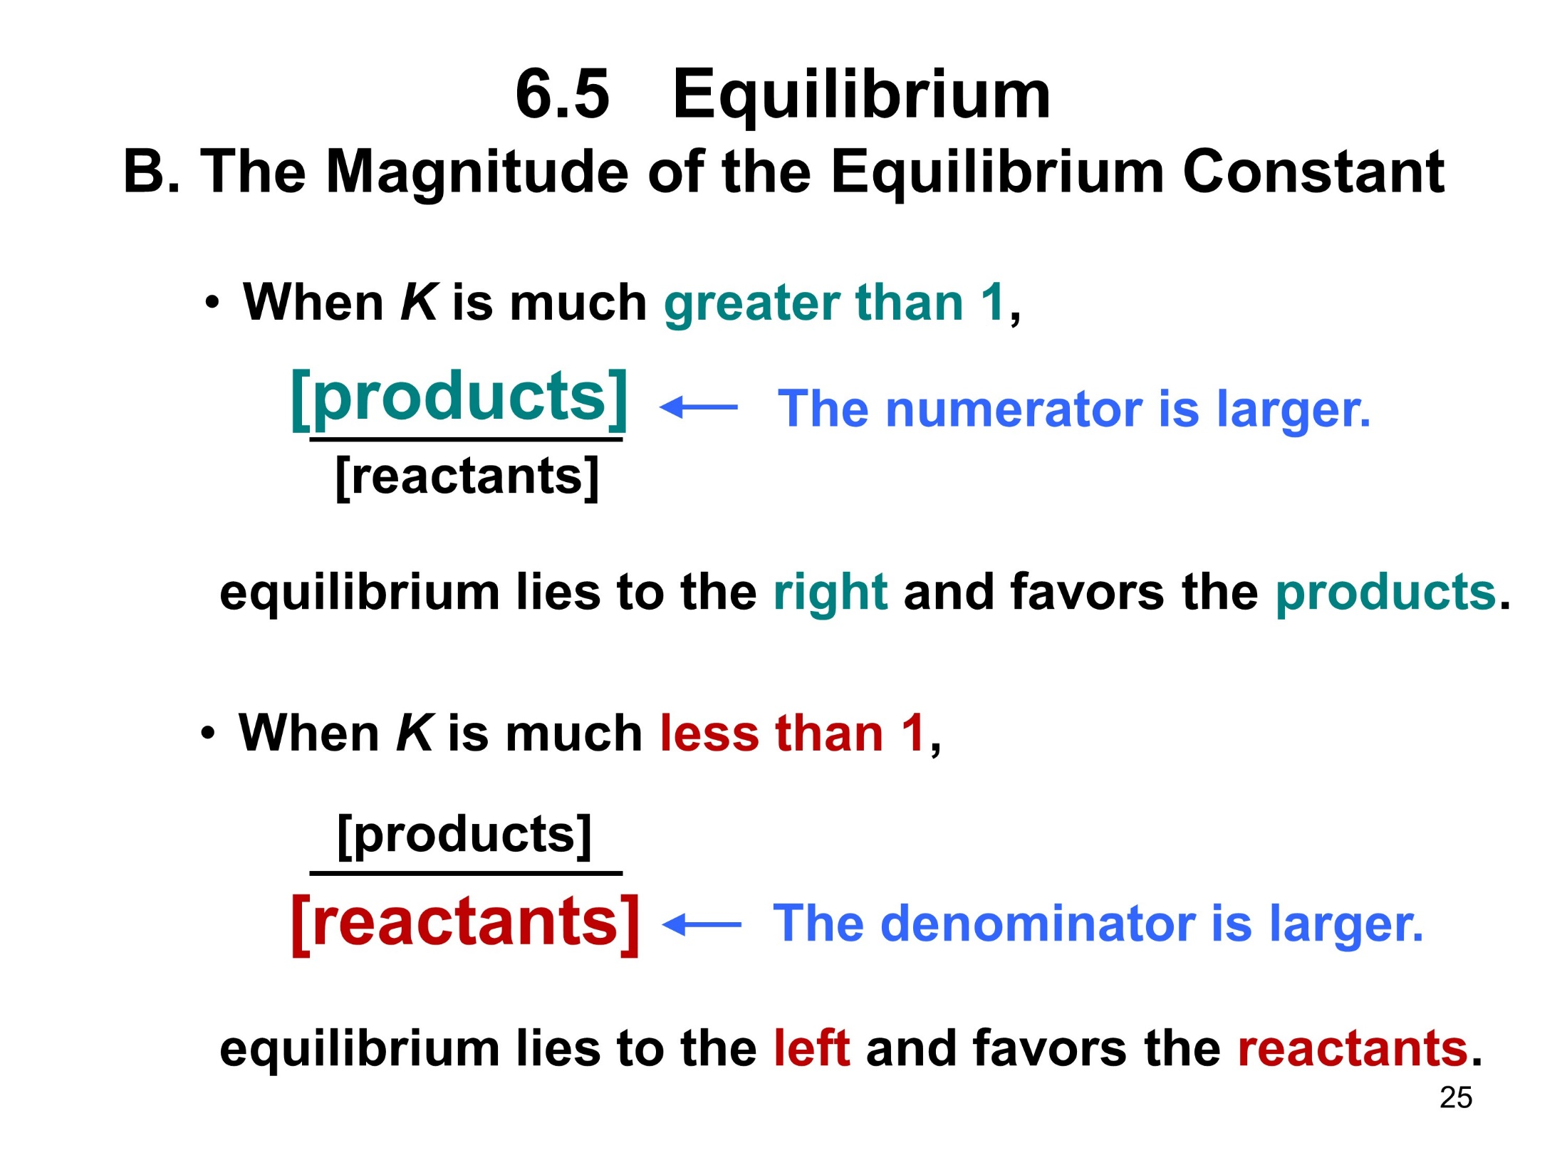
6.5 Equilibrium (4)
The Magnitude of the Equilibrium Constant
When K is much greater than 1,
equilibrium lies to the right and favors the products.
When K is much less than 1,
equilibrium lies to the left and favors the reactants.

Slide 26
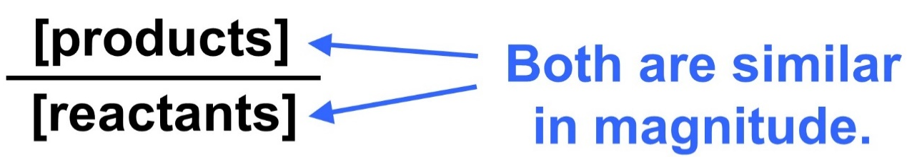
6.5 Equilibrium (5)
The Magnitude of the Equilibrium Constant
When K is around 1 (0.01 < K < 100),
both reactants and products are present in
similar amounts.

Slide 27
6.5 Equilibrium (6)
The Magnitude of the Equilibrium Constant
For the reaction:
The product is favored because K > 1.
The equilibrium lies to the right.

Slide 28
6.5 Equilibrium (7)
The Magnitude of the Equilibrium Constant
Table 6.4 How the Magnitude of K Relates to the Direction of Equilibrium
Value of K | Position of Equilibrium
K > 1 | Equilibrium favors the products. Equilibrium lies to the right.
K < 1 | Equilibrium favors the reactants. Equilibrium lies to the left.
K ≈ 1 | Both the reactants and products are present at equilibrium.

Slide 29
6.5 Equilibrium (8)
Calculating the Equilibrium Constant
HOW TO Calculate the Equilibrium Constant for a Reaction
Example
Calculate K for the reaction between the
general reactants
and
The
equilibrium concentrations are as follows:
[AB] = 0.50 M

Slide 30
6.5 Equilibrium (9)
Calculating the Equilibrium Constant
HOW TO Calculate the Equilibrium Constant for a Reaction
Write the expression for the equilibrium constant from the balanced equation.
Step [1]

Slide 31
6.5 Equilibrium (10)
Calculating the Equilibrium Constant
HOW TO Calculate the Equilibrium Constant for a Reaction
Substitute the given concentrations in the equilibrium expression and calculate K.
Step [2]
The unit of the answer is always mol/L (or M), which is usually omitted.

Slide 32
6.6 Le Châtelier’s Principle (1)
If a chemical system at equilibrium is disturbed or
stressed, the system will react in a direction that
counteracts the disturbance or relieves the stress.
Some of the possible disturbances:
Concentration changes
Temperature changes
Pressure changes

Slide 33
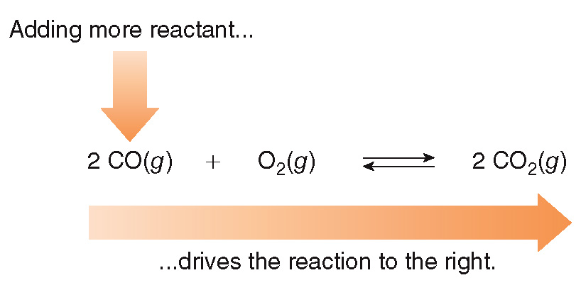
6.6 Le Châtelier’s Principle (2)
Concentration Changes
What happens if [CO(g)] is increased?
The concentration of O₂(g) will decrease.
The concentration of CO₂(g) will increase.

Slide 34
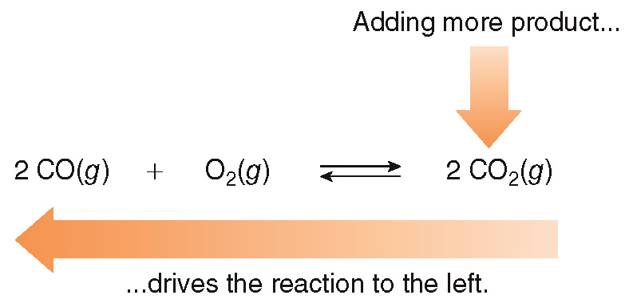
6.6 Le Châtelier’s Principle (3)
Concentration Changes
What happens if [CO₂(g)] is increased?
The concentration of CO(g) will increase.
The concentration of O₂(g) will increase.

Slide 35
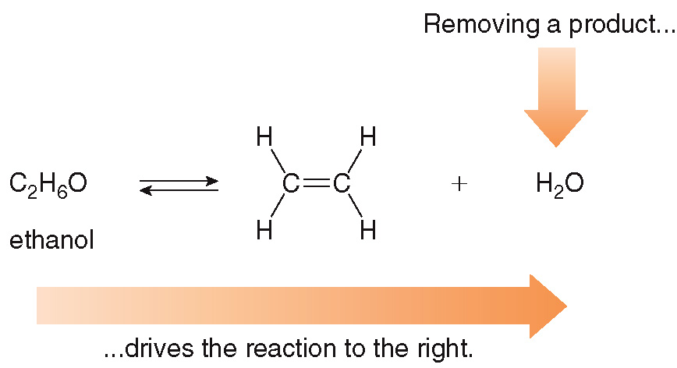
6.6 Le Châtelier’s Principle (4)
Concentration Changes
What happens if a product is removed?
The concentration of ethanol will decrease.
The concentration of the other product (C₂H₄) will increase.

Slide 36
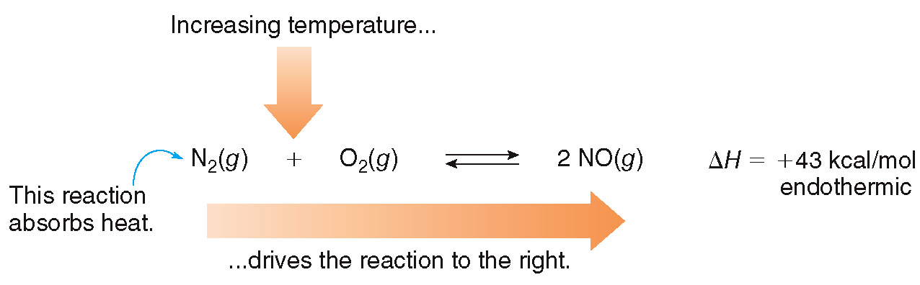
6.6 Le Châtelier’s Principle (5)
Temperature Changes
When the temperature is increased, the reaction that absorbs heat is favored.
An endothermic reaction absorbs heat, so increasing the temperature favors the forward reaction.

Slide 37
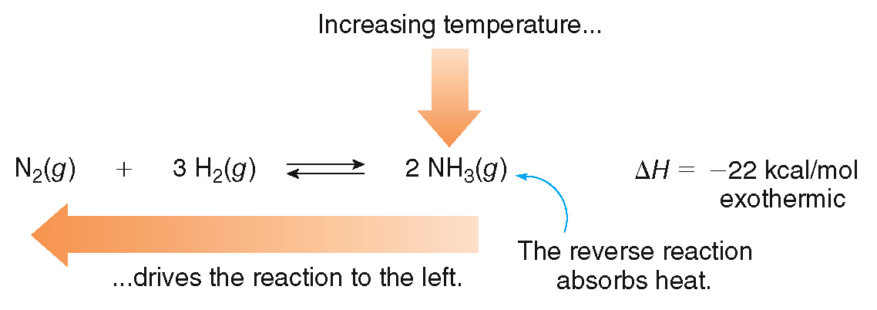
6.6 Le Châtelier’s Principle (6)
Temperature Changes
An exothermic reaction releases heat, so increasing the temperature favors the reverse reaction.
Conversely, when the temperature is decreased, the reaction that adds heat is favored.

Slide 38
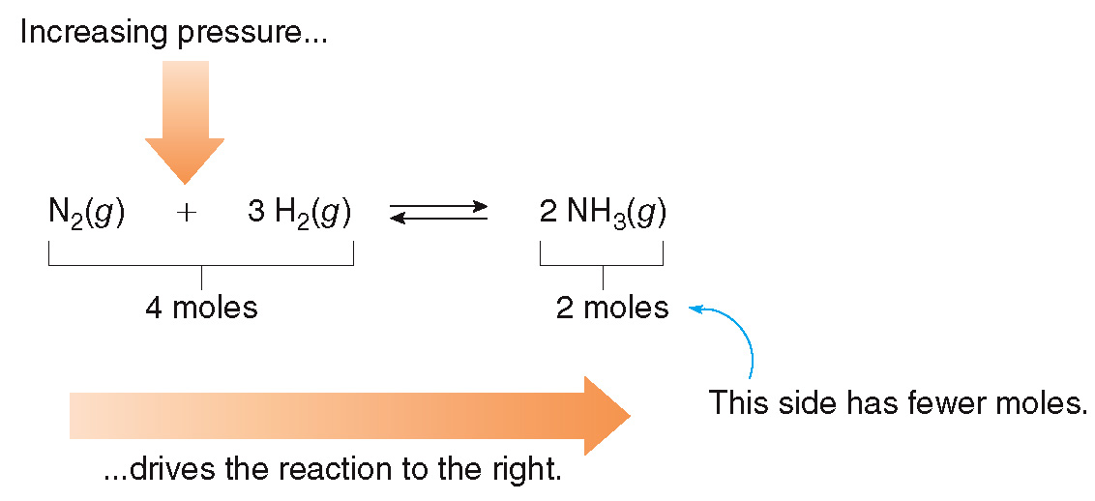
6.6 Le Châtelier’s Principle (7)
Pressure Changes
When pressure increases, equilibrium shifts in the direction that decreases the number of moles in order to decrease pressure.

Slide 39
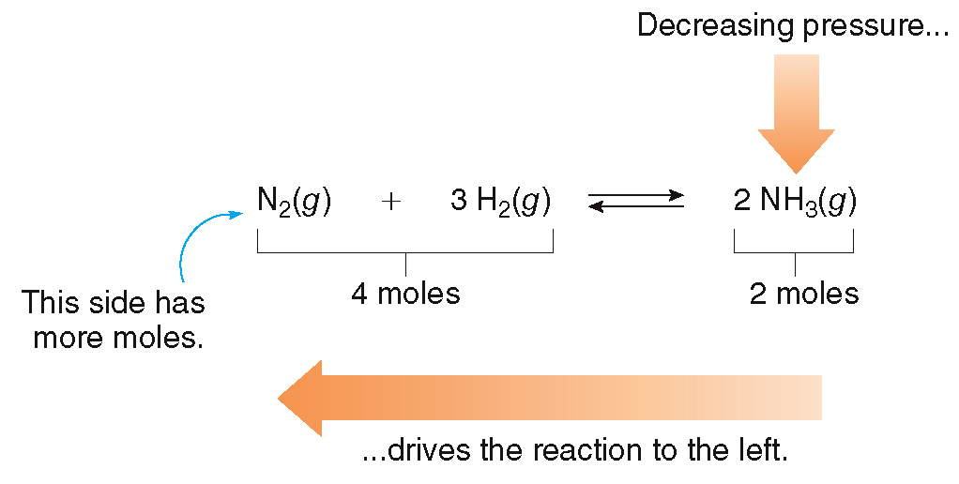
6.6 Le Châtelier’s Principle (8)
Pressure Changes
When pressure decreases, equilibrium shifts in the direction that increases the number of moles in order to increase pressure.

Slide 40
6.6 Le Châtelier’s Principle Summary
Table 6.5 The Effects of Changes in Conditions on Equilibrium
Change | Effect on Equilibrium
Concentration
Adding reactant | Equilibrium favors the products.
Removing reactant | Equilibrium favors the reactants.
Adding product | Equilibrium favors the reactants.
Removing product | Equilibrium favors the products.
Temperature
Increasing temperature | In an endothermic reaction, equilibrium favors the products. In an exothermic reaction, equilibrium favors the reactants.
Decreasing temperature | In an endothermic reaction, equilibrium favors the reactants. In an exothermic reaction, equilibrium favors the products.
Pressure
Increasing pressure | Equilibrium favors the side that has fewer moles.
Decreasing pressure | Equilibrium favors the side that has more moles.

Slide 41
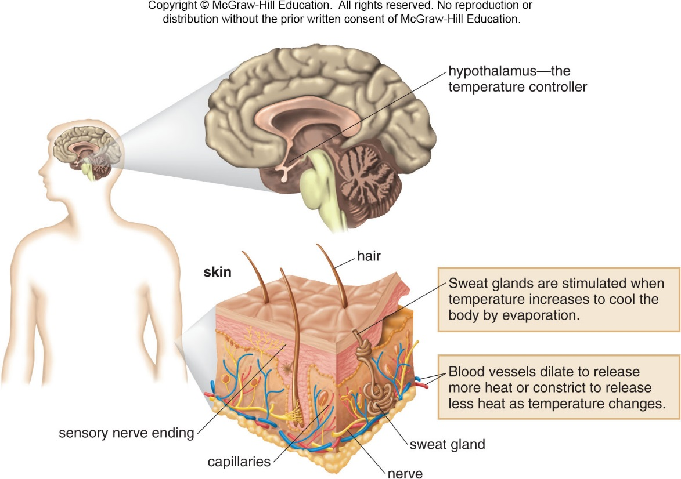
6.7 Focus on the Human Body
Body Temperature

